Slide 1
Snake game
Project : 1st Mechatronics
In c++
Dr. Abdelhady Mostafa
By Diea hassan

Slide 2
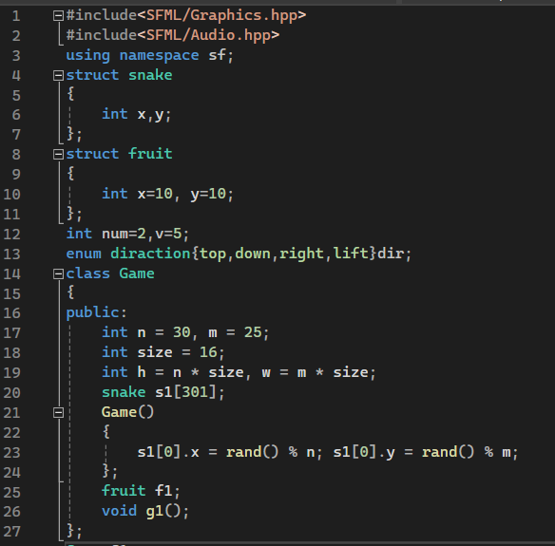
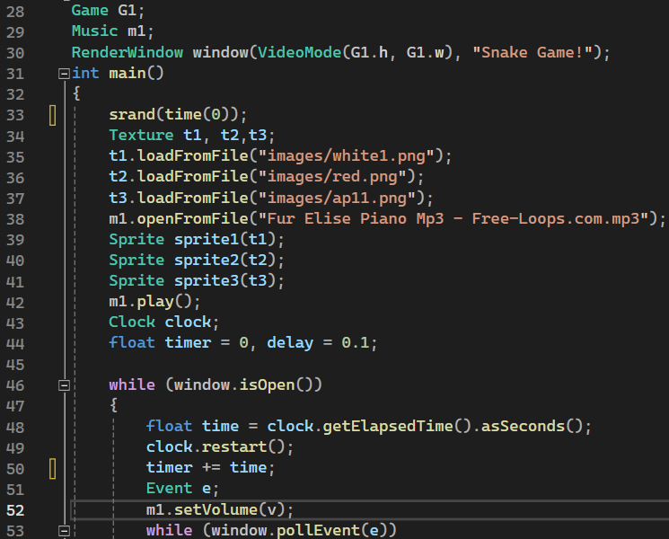

Slide 3
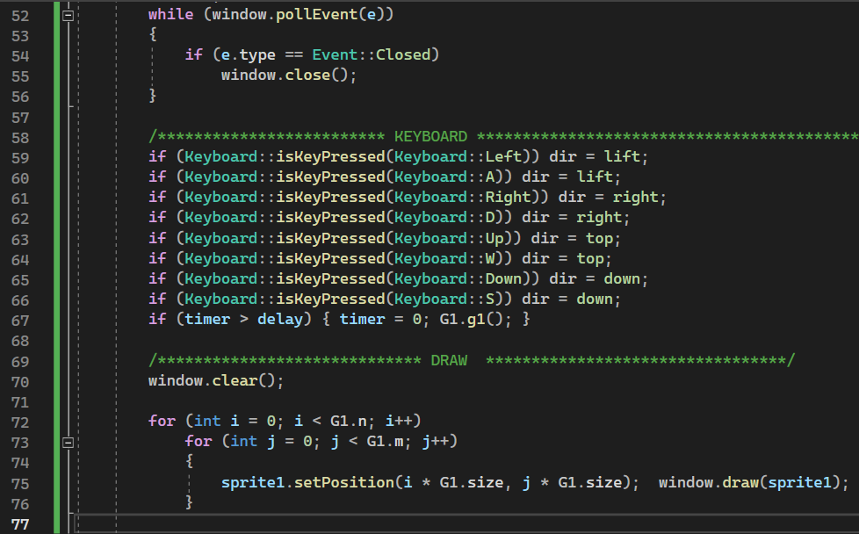
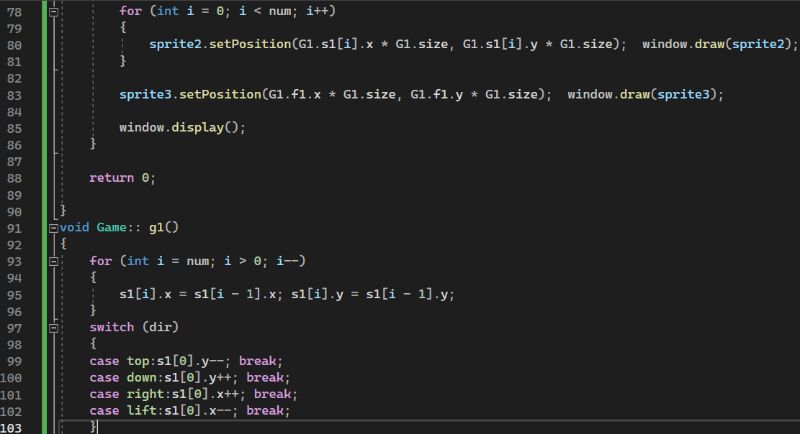

Slide 4
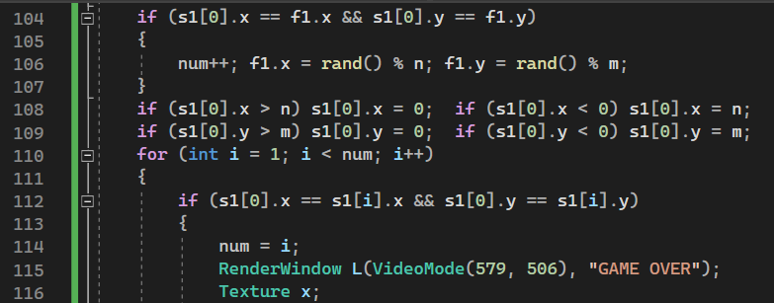
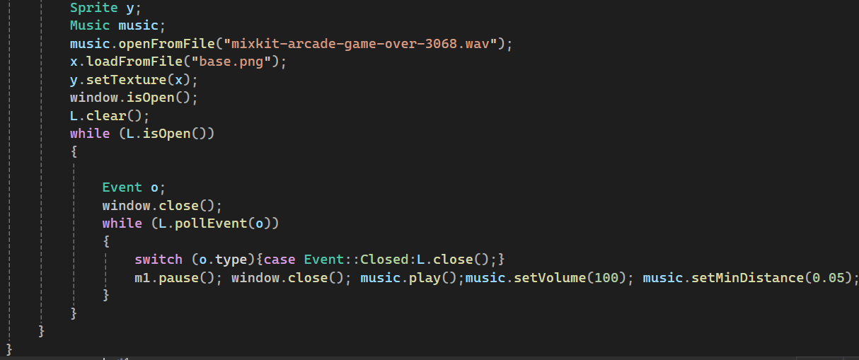

Slide 6



Slide 7
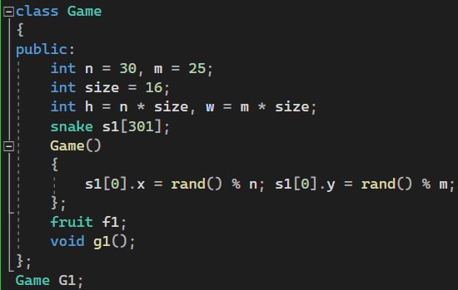
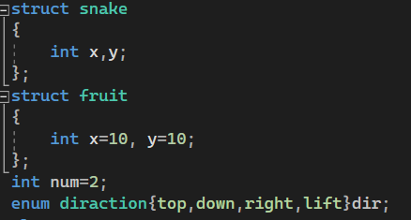
Class for game
Have 5 variable
S1 is array of struction snake
F1 is variabble of struction fruit
Struction for snake and fruit
Enumeration of direction
N for number of space in x
M for number of space in y
Size for size of space
H is length of height
W is length of weight
Function g1

Slide 8

RenderWindow is a class in <SFML/Graphics> that has two argument
( int , string or char)

Slide 9
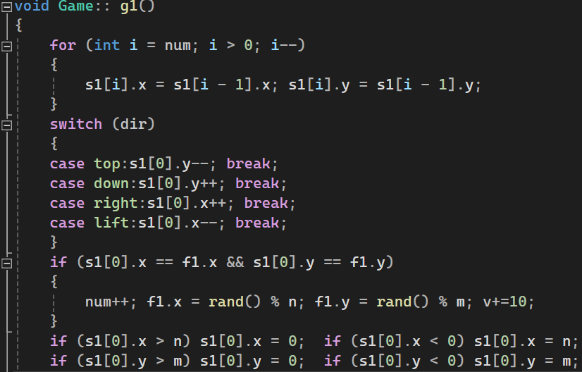
This to shift value of head snake to tail
This to help us in move snake
This to grow snake
This to make snake return to map when it leave

Slide 10
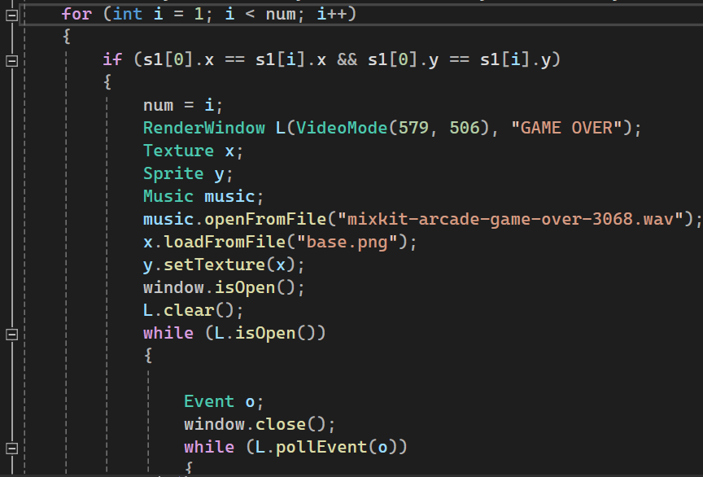
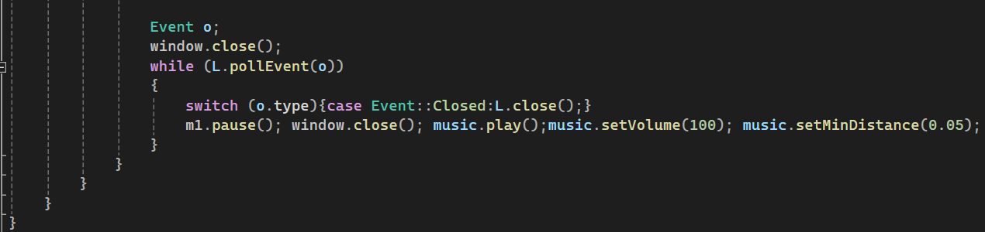
To decision when play lose

Slide 11
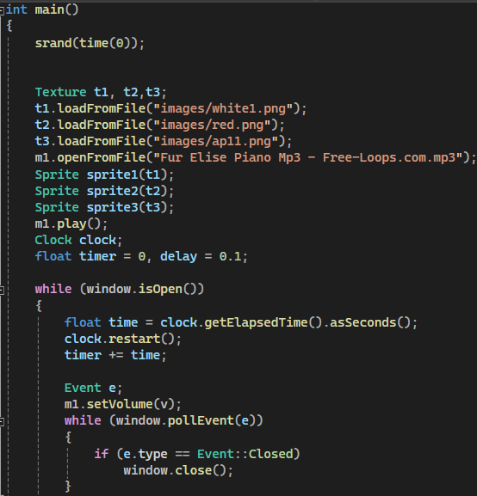
To load image and audio
To set speed to snake
Set volume of audio

Slide 12
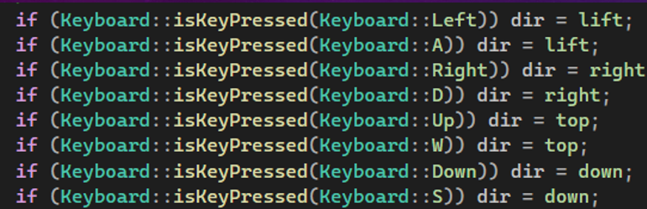
To receive orders keyboard
To set speed snake

Slide 13
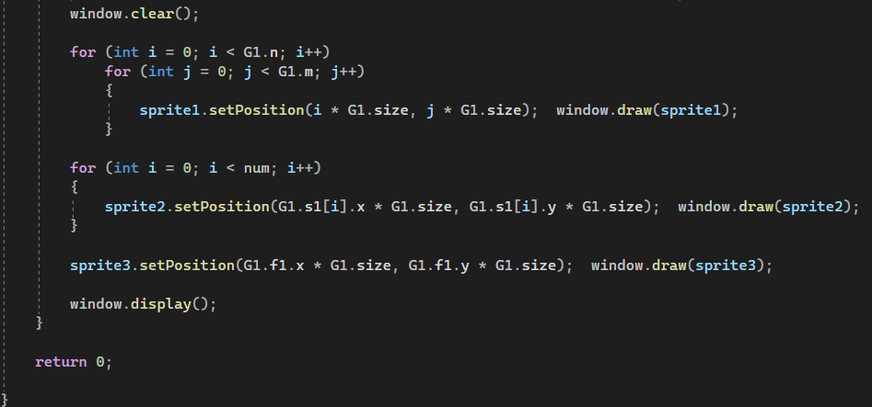
1
2
3
1 | Draw map
2 | Draw snake
3 | Draw fruit

Slide 14
Any Questions?

